Slide 1

A Formal Approach for Developing Commercial E-Agriculture Application: An OCL Modelling Perspective
Authors: Irfan Ahmed, Umm-e-Habiba, sadia Naseer, Khadija Batool, jabar Mahmood
Presenter: Irfan ahmed
University of sialkot
International Conference on Computational Intelligent System 2024

Slide 2
Outline:
Abstract
Introduction
Proposed Methodology
Case Study of E-Agriculture System
OCL Based SRS
Evaluation
Conclusion

Slide 3
Abstract
The agriculture sector is increasingly adopting digital tools to boost efficiency
Formal methods in building e-agriculture systems
Formal methods for Safety Critical System and Commercial Applications
OCL based SRS of E – Agriculture System
Reduce Verification, Development Time, Cost and SRS Ambiguity
Enhance Software Quality and Customer Satisfaction

Slide 4
Introduction
Primary Objective of Software Engineering
E – Agriculture
Formal Methods

Slide 5
Literature Review
Authors | Publishing Year | Strength | Limitation
J. Kandu et al. [12] | 2023 | Focused on enhancing both agricultural practices and the overall development of the country | Much Costly with high development time
T. Adao et al. [13] | 2023 | Developed “mySense”, a wide-ranging, sensor-based data management system designed for enhancing accurate farming practices and promote agricultural sustainability | Lacks customer satisfaction, trust and quality. It had many SRS ambiguities.
J. Aleotti et al [14] | 2024 | The mobile application allowed agrarians to input user data into the decision support system, request irrigation plans from the server and control the irrigation process in real time | Higher Development time, cost and budget.
F. Pinet et al [17] | 2023 | developed e-agriculture system by using OCL for managing organic waste | did not address the issue of ambiguity

Slide 6
Case Study of E - Agriculture
Functional Requirements of E – Agriculture
Non – Functional Requirements of E – Agriculture

Slide 7
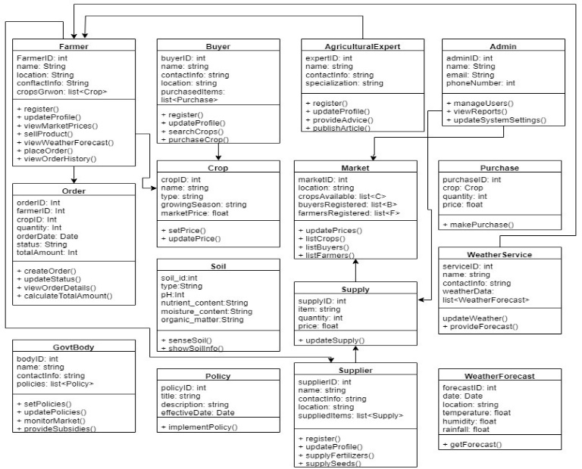
Class Diagram ( Traditional Method )
Figure 1: class diagram of E-Agriculture System

Slide 8
OCL – Based SRS of E – Agriculture System
Context
invariant
pre
post
OCL Specifications for Class “Farmer”:
OCL for to register:
context Farmer:
inv UniqueFarmerID: Farmer.allInstances() → isUnique()
inv ValidEmail: email.matches ('[a-zA-Z0-9._%+-] + @[a-zA-Z0-9.-]+\\.[a-zA-Z]{2,}')
inv RegistrationDateNotFuture: registrationDate <= Date.today()

Slide 9
Results:
TABLE 1: Time Comparison of Both Teams to develop E-Agriculture
Time Aspect | Based on OCL | Traditional Development
 | Days | Days
Planning and SRS | 28 | 21
Design and Development | 36 | 53
Testing | 13 | 27
Verification and Validation | 19 | 31
Total Days | 96 | 132

Slide 10
Table 2: Quality Comparison Between Both Teams
Quality Aspect | No. of Errors Found |  | Quality Improvement%
 | Team A | Team B | Team A | Team B
System Requiremnets | 5 | 9 | 95% | 70%
Safety Properties | 2 | 11 | 94% | 42%
Functional Specifications | 3 | 15 | 90% | 31%
Interface Definitions | 1 | 10 | 93% | 67%
Performance Metrics | 0 | 12 | 100% | 59%

Slide 11
Table 3: Cost Reduction Between OCL Based SRS and Traditional Methods
Cost Aspect | Based on OCL | Traditional Development
 | Cost Reduction | Cost Reduction
Requirement Analysis | 30% | 10%
Design | 25% | 15%
Development | 20% | 10%
Testing and Validation | 35% | 20%
Maintenance | 40% | 25%

Slide 12
Table 4. Ambiguity Reduction Comparison Between Ocl Based Srs And Traditional Development
Ambiguity Aspect | OCL Based SRS | Traditional Development
 | Ambiguity Reduction | Ambiguity Reduction
SRS | 50% | 10%
Design | 35% | 15%
Implementation | 30% | 10%
Testing | 40% | 20%
Maintenance | 45% | 25%
Communication | 50% | 30%

Slide 14
OCL Based Development Cost Reduction

Slide 15
Conclusion
Formal Methods are not only beneficial for safety critical system but also for
commercial applications
(OCL) greatly improves the formal modeling of the E-Agriculture System
it reduces cost, development time and SRS ambiguities
It improves Software Quality and enhance customer trust.

Slide 16
Thank You

